Slide 1
Coding Standards and Guidelines

Slide 2
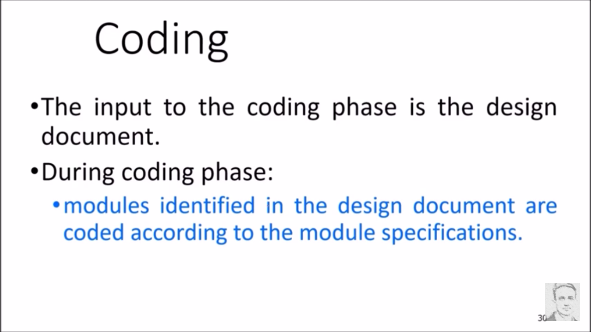


Slide 3
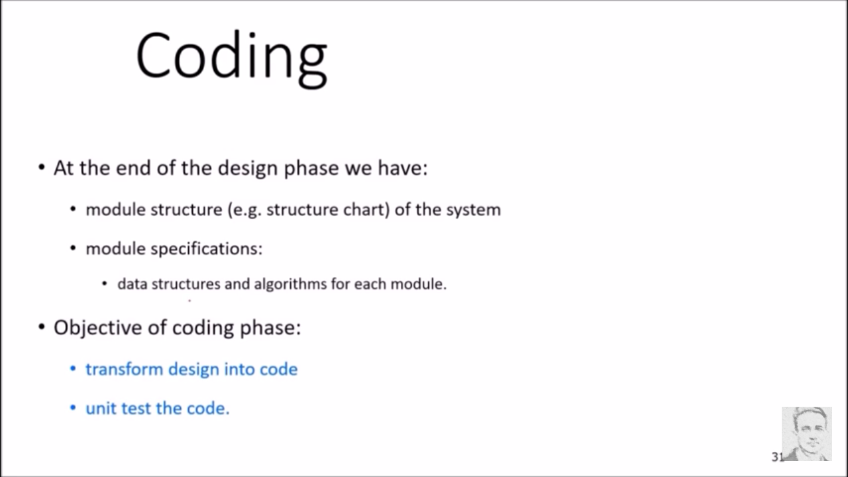

Slide 4
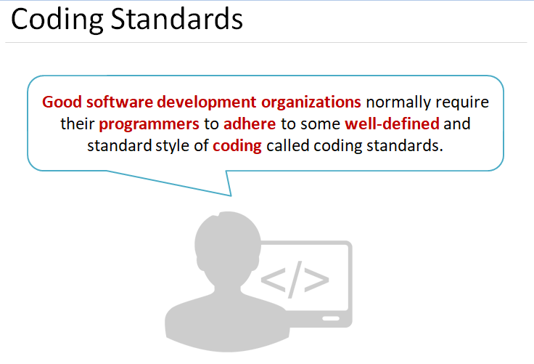

Slide 5
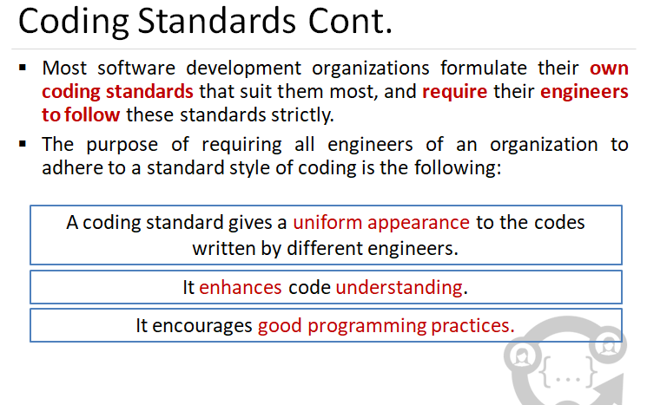

Slide 6
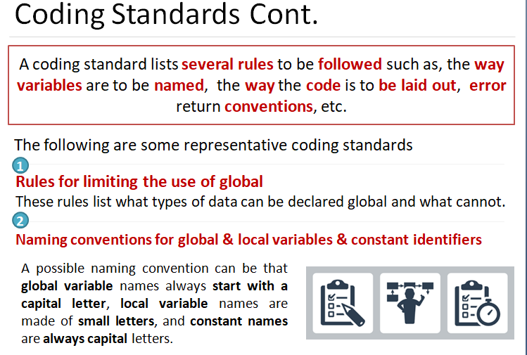

Slide 7
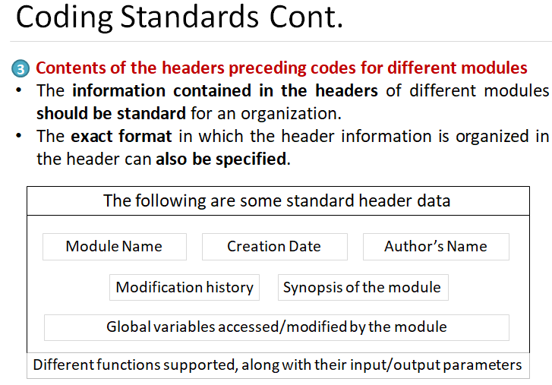

Slide 8
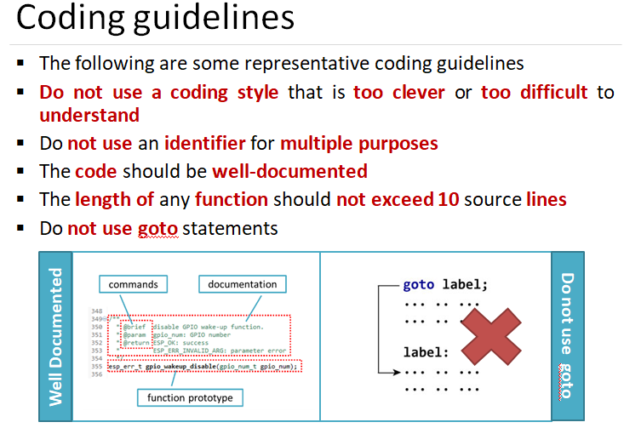

Slide 9
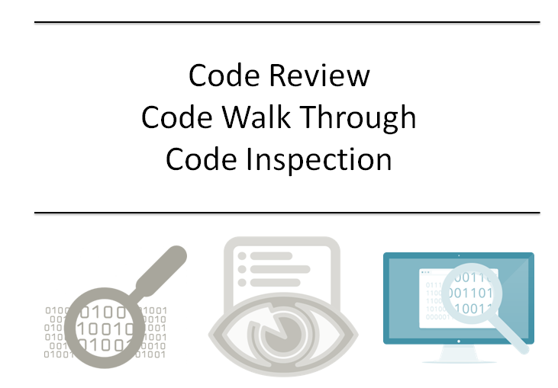

Slide 10
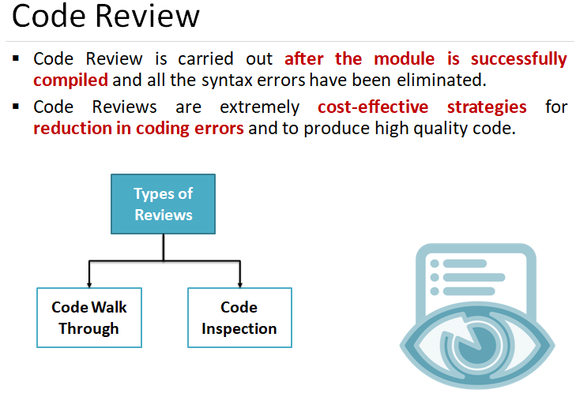

Slide 11
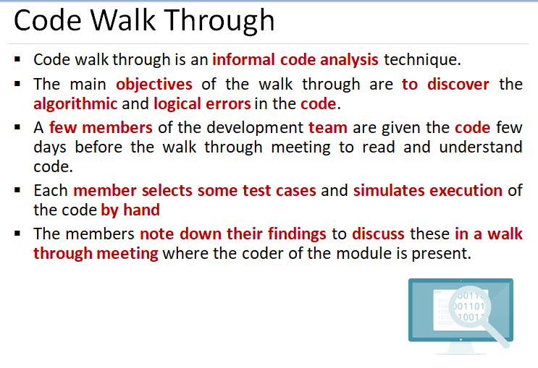

Slide 12
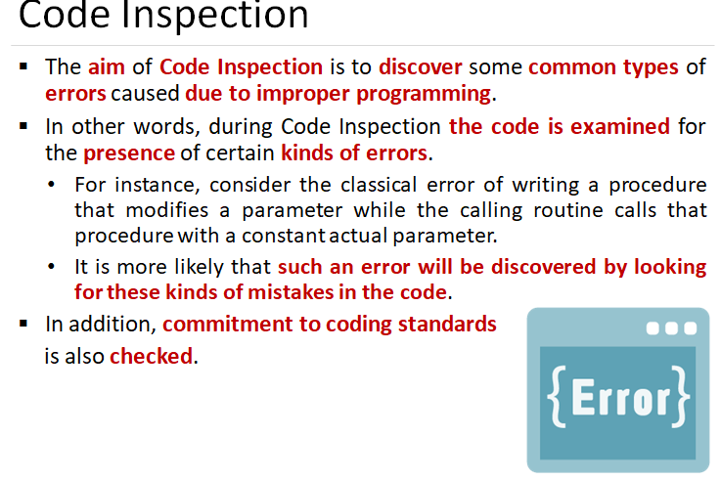

Slide 13
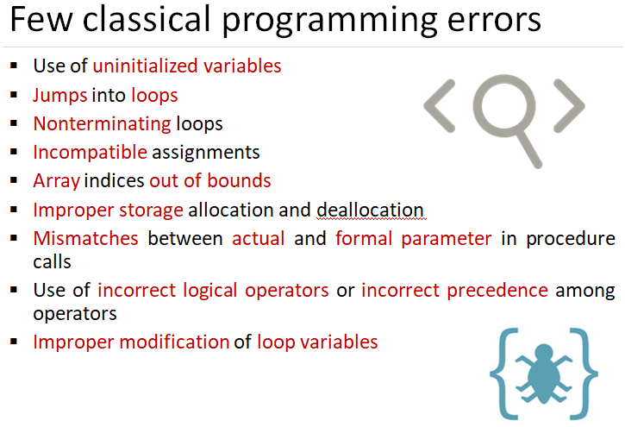

Slide 14


Slide 15
Aim of testing
The aim of the testing process is to identify all defects existing in a software product.
Testing is carried out:
a)To check the errors of program
b) To check whether program is giving expected output as per input specifications.
Testing a program consist of subjecting the program to set of test cases and observing if program behaves as expected.If program fails to behave as expected then condition under which failure occurs are noted for later debugging and correction

Slide 16
Terms used in testing
Test case: This is the triplet [I,S,O], where I is the data input to the system, S is the state of the system at which the data is input, and O is the expected output of the system.

Slide 17
Test suite: This is the set of all test cases with which a given software product is to be tested.
Consider the following example code segment which finds the greater of two integer values x and y. This code segment has a simple programming error.
If (x>y) max = x;
else max = y;
For the above code segment, the test suite, {(x=3,y=2);(x=2,y=3)} can detect the error, whereas a larger test suite {(x=3,y=2);(x=4,y=3);(x=5,y=1)} does not detect the error. So, it would be incorrect to say that a larger test suite would always detect more errors than a smaller one, unless of course the larger test suite has also been carefully designed.

Slide 18
Verification Vs Validation
Verification is the process of determining whether the output of one phase of software development conforms to that of its previous phase, whereas validation is the process of determining whether a fully developed system conforms to its requirements specification.
Thus while verification is concerned with phase containment of errors, the aim of validation is that the final product be error free.

Slide 19
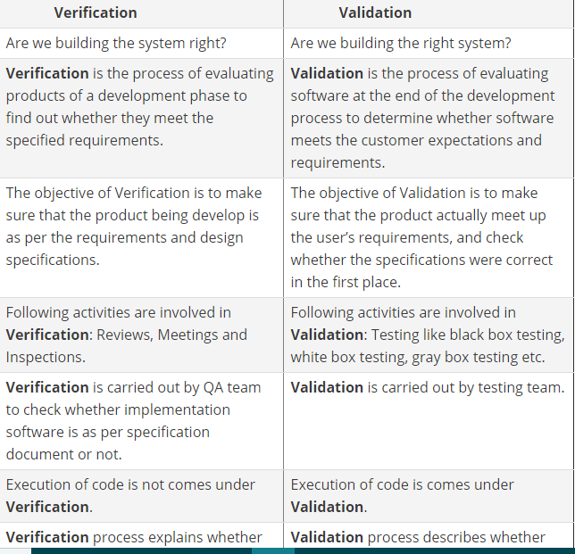

Slide 20
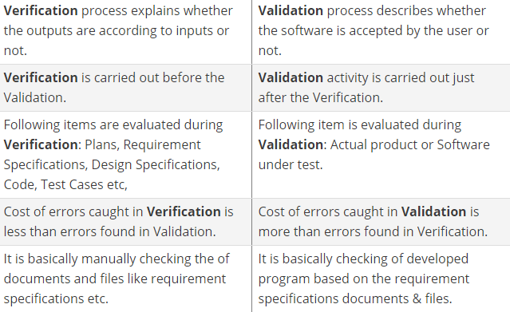

Slide 21
Testing in the large vs. testing in the small
Software products are normally tested first at the individual component (or unit) level. This is referred to as testing in the small.
After testing all the components individually, the components are slowly integrated and tested at each level of integration (integration testing).
Finally, the fully integrated system is tested (called system testing). Integration and system testing are known as testing in the large.

Slide 22
Unit testing
Unit testing is undertaken after a module has been coded and successfully reviewed.
Unit testing (or module testing) is the testing of different units (or modules) of a system in isolation.
When developer is coding the software it may happen that the dependent modules are not completed for testing,in such cases developers use stubs and drivers to simulate the called(stub) and caller(driver) units. Unit testing requires stubs and drivers, stubs simulates the called unit and driver simulates the calling unit.

Slide 23
STUBS:
Assume you have 3 modules, Module A, Module B and module C. Module A is ready and we need to test it, but module A calls functions from Module B and C which are not ready, so developer will write a dummy module which simulates B and C and returns values to module A. This dummy module code is known as stub.

Slide 24
DRIVERS:
Now suppose you have modules B and C ready but module A which calls functions from module B and C is not ready so developer will write a dummy piece of code for module A which will return values to module B and C. This dummy piece of code is known as driver.

Slide 25
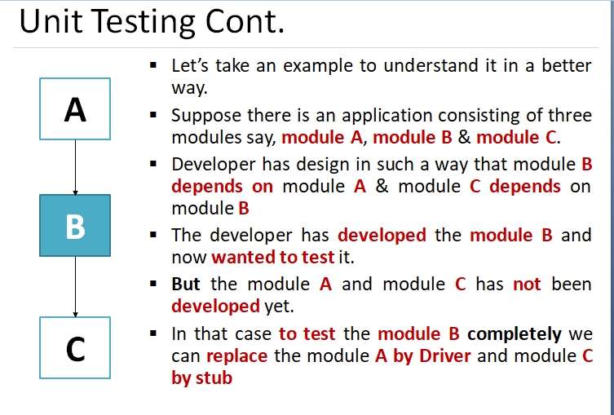

Slide 26
What is Black Box Testing?
Black box testing, which is also known as behavioral, closed-box, specification-based or eye-to-eye testing, is a Software Testing method that analyses the functionality of a software/application without knowing much about the internal structure/design of the item that is being tested and compares the input value with the output value.
The main focus in black box testing is on the functionality of the system as a whole.

Slide 27
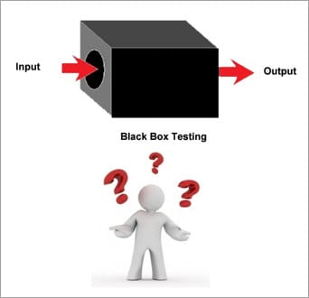

Slide 28
Types of Black Box Testing
Practically, there are several types of black box testing that are possible but if we consider the major variant of it then below mentioned are the two fundamental ones.
#1) Functional Testing
This type deals with the functional requirements or specifications of an application. Here, different actions or functions of the system are being tested by providing the input and comparing the actual output with the expected output.

Slide 29
For Example, when we test a Dropdown list, we click on it and verify that it expands and all the expected values are showing in the list.
Few major types of Functional Testing are:
Smoke Testing
Integration Testing
System Testing
Regression Testing
User Acceptance Testing

Slide 30
Non-Functional Testing
Apart from the functionalities of the requirements, there are several non-functional aspects as well that are required to be tested to improve the quality and performance of the application.
Few major types of Non-functional testing include:
Usability Testing
Performance Testing
Compatibility Testing
Stress Testing

Slide 31
Black Box Testing Techniques
In order to systematically test a set of functions, it is necessary to design test cases. Testers can create test cases from the requirement specification document using the following black box testing techniques.
Equivalence Partitioning
Boundary Value Analysis

Slide 32
Equivalence Partitioning
This technique is also known as Equivalence Class Partitioning (ECP). In this technique, input values to the system or application are divided into different classes or groups based on its similarity in the outcome.
Hence, instead of using each and every input value we can now use any one value from the group/class to test the outcome. In this way, we can maintain the test coverage while we can reduce a lot of rework and most importantly the time spent.

Slide 33
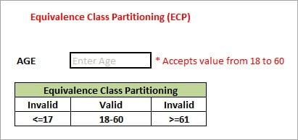
Example:

Slide 34
As present in the above image, an “AGE” text field accepts only the numbers from 18 to 60. There will be three set of classes or groups.
Two invalid classes will be:
a) Less than or equal to 17.
b) Greater than or equal to 61.
One valid class will be anything between 18 to 60.
We have thus reduced the test cases to only 3 test cases based on the formed classes thereby covering all the possibilities. So, testing with any one value from each set of the class is sufficient to test the above scenario.

Slide 35
Boundary Value Analysis:
From the name itself, we can understand that in this technique we focus on the values at boundaries as it is found that many applications have a high amount of issues on the boundaries.
Boundary means the values near the limit where the behavior of the system changes. In boundary value analysis both the valid inputs and invalid inputs are being tested to verify the issues.

Slide 36
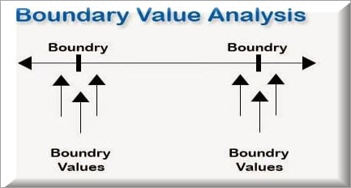
Example

Slide 37
If we want to test a field where values from 1 to 100 should be accepted then we choose the boundary values: 1-1, 1, 1+1, 100-1, 100, and 100+1. Instead of using all the values from 1 to 100, we just use 0, 1, 2, 99, 100, and 101.

Slide 38
What is White Box Testing?
“White box testing” (also known as clear, glass box or structural testing) is a testing technique which evaluates the code and the internal structure of a program.

Slide 39
Types and Techniques of White Box Testing
Statement Coverage
Branch Coverage
Path Coverage

Slide 40
Statement coverage
In a programming language, a statement is nothing but the line of code or instruction for the computer to understand and act accordingly.
Hence “Statement Coverage”, as the name itself suggests, it is the method of validating whether each and every line of the code is executed at least once.

Slide 41
Branch Coverage:
“Branch” in a programming language is like the “IF statements”. An IF statement has two branches: True and False.
So in Branch coverage (also called Decision coverage), we validate whether each branch is executed at least once.
In case of an “IF statement”, there will be two test conditions:
One to validate the true branch and,
Other to validate the false branch.
Hence, in theory, Branch Coverage is a testing method which is when executed ensures that each and every branch from each decision point is executed.

Slide 42
Path Coverage
Path coverage tests all the paths of the program. This is a comprehensive technique which ensures that all the paths of the program are traversed at least once.
Path Coverage is even more powerful than Branch coverage. This technique is useful for testing the complex programs.

Slide 43
White Box Testing Example
Consider the below simple pseudocode:
INPUT A & B
C = A + B
IF C>100
PRINT “ITS DONE”

Slide 44
Statement Coverage
For Statement Coverage – we would only need one test case to check all the lines of the code.
That means:
If I consider TestCase_01 to be (A=40 and B=70), then all the lines of code will be executed.
Now the question arises:
Is that sufficient?
What if I consider my Test case as A=33 and B=45?

Slide 45
Because Statement coverage will only cover the true side, for the pseudo code, only one test case would NOT be sufficient to test it. As a tester, we have to consider the negative cases as well.
Hence for maximum coverage, we need to consider “Branch Coverage”, which will evaluate the “FALSE” conditions.

Slide 46
So now the pseudo code becomes:
INPUT A & B
C = A + B
IF C>100
PRINT “ITS DONE”
ELSE
PRINT “ITS PENDING”

Slide 47
Since Statement coverage is not sufficient to test the entire pseudo code, we would require Branch coverage to ensure maximum coverage.
So for Branch coverage, we would require two test cases to complete the testing of this pseudo code.
TestCase_01: A=33, B=45
TestCase_02: A=25, B=30
With this, we can see that each and every line of the code is executed at least once.

Slide 48
Path Coverage:
As said earlier, Path coverage is used to test the complex code , which basically involve loop statements or combination of loops and decision statements.

Slide 49
Consider this pseudocode:
INPUT A & B
C = A + B
IF C>100
PRINT “ITS DONE”
END IF
IF A>50
PRINT “ITS PENDING”
END IF

Slide 50
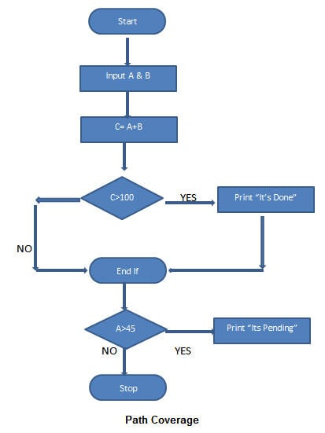

Slide 51
In order to have the full coverage, we would need following test cases:
TestCase_01: A=50, B=60
TestCase_02: A=55, B=40
TestCase_03: A=40, B=65
TestCase_04: A=30, B=30

Slide 52
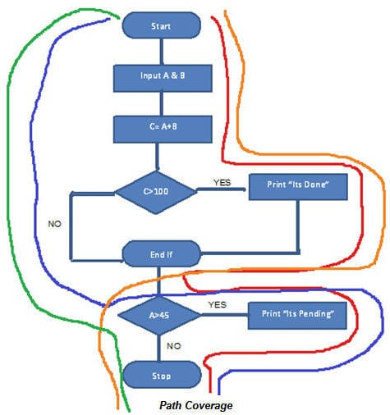

Slide 53
Red Line – TestCase_01 = (A=50, B=60)
Blue Line = TestCase_02 = (A=55, B=40)
Orange Line = TestCase_03 = (A=40, B=65)
Green Line = TestCase_04 = (A=30, B=30)

Slide 54
What is integration testing?
The meaning of Integration testing is quite straightforward- Integrate/combine the unit tested module one by one and test the behavior as a combined unit.
We normally do Integration testing after “Unit testing”. Once all the individual units are created and tested, we start combining those “Unit Tested” modules and start doing the integrated testing.

Slide 55
Types of Integration Testing
Big Bang Approach
Bottom-up approach
Top-down approach.
Sandwiched or Mixed Testing

Slide 56
Big Bang Approach
Big bang approach integrates all the modules in one go i.e. it does not go for integrating the modules one by one.
It verifies if the system works as expected or not once integrated.
If any issue is detected in the completely integrated module, then it becomes difficult to find out which module has caused the issue.
Big bang approach is a time-consuming process of finding a module which has a defect itself

Slide 57
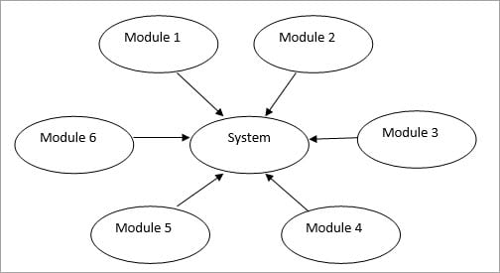

Slide 58
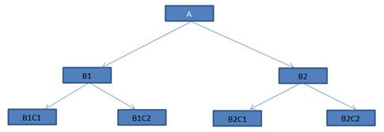
Top-down approach
This technique starts from the topmost module and gradually progress towards the lower modules. Only the top module is unit tested in isolation. After this, the lower modules are integrated one by one. The process is repeated until all the modules are integrated and tested.

Slide 59
In the context of our figure, testing starts from Module A, and lower modules B1 and B2 are integrated one by one. Now here the lower modules B1 and B2 are not actually available for integration. So in order to test the topmost modules A, we develop “STUBS”.

Slide 60
Bottom-up approach
Bottom-up testing, as the name suggests starts from the lowest or the innermost unit of the application, and gradually moves up.
The Integration testing starts from the lowest module and gradually progresses towards the upper modules of the application.
This integration continues till all the modules are integrated and the entire application is tested as a single unit.

Slide 62
In this case, modules B1C1, B1C2 & B2C1, B2C2 are the lowest module which is unit tested. Module B1 & B2 are not yet developed.
The functionality of Module B1 and B2 is that it calls the modules B1C1, B1C2 & B2C1, B2C2. Since B1 and B2 are not yet developed, we would need some program or a “stimulator” which will call the B1C1, B1C2 & B2C1, B2C2 modules.
These stimulator programs are called DRIVERS.

Slide 63
Sandwich testing
Sandwich testing which combines the features of both Top-down and bottom-up approach.
Sandwich testing plays a very important role here, where both, the Top down and bottom up testing are started simultaneously.
In case of our figure, our testing will start from B1 and B2, where one arm will test the upper module A and another arm will test the lower modules B1C1, B1C2 & B2C1, B2C2.
Since both the approach starts simultaneously, this technique is a bit complex

Slide 64
System testing
System testing is the type of testing to check the behaviour of a complete and fully integrated software product based on the software requirements specification (SRS) document
Three types of System Testing
1.Alpha Testing
2.Beta Testing
3.Acceptance Testing

Slide 65
Alpha Testing : Alpha testing refers to the system testing carried out by the test team within the development organization.
Beta Testing : Beta testing is the system testing performed by a selected group of friendly customers.
Acceptance Testing : Acceptance testing is the system testing performed by the customer to determine whether to accept or reject the delivery of the system.

Slide 66
Control Flow graph
Control flow graph describe the sequence in which the different instructions of a program get executed.
In other words a control flow graph describes how the control flows through the program.
Consists of two major components:
  Node:
    Represents a stretch of sequential code statements with no branches.
  Directed Edge (also called arc):
    Represents a branch, alternative path in execution.
Path:
  A collection of Nodes linked with Directed Edges

Slide 67
Simple Examples
Sequence
a=5
b=a*2-1
1
2
Ans of b=9
CFG

Slide 68
More Examples
Selection:
1.if(a>b) if(5>9)
2.c=3;
3.Else c=5;
4. c=c*c; c=5*5=10
T
2
1
4
3
F
CFG
Iteration:
1.while(a>b) (5>9)
{ (9>5)
2.b=b-1; b=5-1=4
3.b=b*a; b=4*5=20
}
4. c=a+b;
F
1
2
3
4
T
CFG

Slide 69
Contro flow graph diagram of the program
int compute(int x,int y)
{
1.while(x!=y){ (2!=3)
2.if(x>y) then if(2>3)
3. x=x-y;
4.Else y=y-x;
5 }
6 return x;
}
1
2
4
3
5
6
CFG

Slide 70
McCabe’s Cyclomatic complexity Metric
Cyclomatic complexity is a software metric used to measure the complexity of a program. These metric, measures independent paths through program source code.
Independent path is defined as a path that has at least one edge which has not been traversed before in any other paths.
Cyclomatic complexity is calculated by using the control flow graph of the program

Slide 71
Method 1
The complexity of the program can be defined as -
V(G) = E - N + 2
Where,
E - Number of edges
N - Number of Nodes
From figure E=7 and N=6
Therefore,the cyclometric complexity,
V(G)=7-6+2=3
1
2
4
3
5
6
CFG

Slide 72
Method 2
The complexity of the program can be defined as -
V(G) = Total number of bounded areas+1
Where, in graph Bounded area is any region enclosed by nodes and edges.
Therefore,the cyclometric complexity,
V(G)=2+1=3
1
2
4
3
5
6
CFG

Slide 73
Method 3
The complexity of the program can be defined as -
V(G) = N+1
Where,
N is the number of decision statement of a program.
Therefore,the cyclometric complexity,
V(G)=2+1=3
1
2
4
3
5
6
CFG

Slide 74
Performance Testing
Performance testing is carried out to check whether the system meets the non functional requirements identified in the SRS document.
There are several types of performance testing. Among of them
Stress testing
Volume testing
• Configuration testing
• Compatibility testing
• Regression testing
• Recovery testing
• Maintenance testing
• Documentation testing
• Usability testing a

Slide 75
Stress testing
It is also called endurance testing.
Stress testing evaluates system performance when it is stressed for short periods of time.
For example, suppose an operating system is supposed to support 15 multiprogrammed jobs, the system is stressed by attempting to run 15 or more jobs simultaneously

Slide 76
Volume Testing
It is especially important to check whether the data structures (arrays, queues, stacks, etc.) have been designed to successfully extraordinary situations.
For example, a compiler might be tested to check whether the symbol table overflows when a very large program is compiled.

Slide 77
Configuration Testing
This is used to analyze system behavior in various hardware and software configurations specified in the requirements.

Slide 78
Regression Testing
This type of testing is required when the system being tested is an upgradation of an already existing system to fix some bugs or enhance functionality, performance, etc. Regression testing is the practice of running an old test suite after each change to the system or after each bug fix to ensure that no new bug has been introduced due to the change or the bug fix.
Regression Testing is required when there is a
Change in requirements and code is modified according to the requirement
New feature is added to the software
Defect fixing

Slide 79
Recovery Testing
Recovery testing tests the response of the system to the presence of faults, or loss of power, devices, services, data, etc
Documentation Testing It is checked that the required user manual, maintenance manuals, and technical manuals exist and are consistent. I

Slide 80
Usability Testing
Usability testing concerns checking the user interface to see if it meets all user requirements concerning the user interface

Slide 81
Issues associated with testing
1. Test documentation----- test summary report
2.Regression testing

Slide 82
One of the fields on a form contains a text box which accepts numeric values in the range of 18 to 25. Identify the invalid Equivalence class.
a) 17
b) 19
c) 24
d) 21
Solution
The text box accepts numeric values in the range 18 to 25 (18 and 25 are also part of the class). So this class becomes our valid class. But the question is to identify invalid equivalence class. The classes will be as follows:
Class I: values < 18 => invalid class
Class II: 18 to 25 => valid class
Class III: values > 25 => invalid class
17 fall under invalid class. 19, 24 and 21 fall under valid class. So answer is ‘A’

Slide 83
A program validates a numeric field as follows: values less than 10 are rejected, values between 10 and 21 are accepted, values greater than or equal to 22 are rejected. Which of the following covers the MOST boundary values?
a. 9,10,11,22
b. 9,10,21,22
c. 10,11,21,22
d. 10,11,20,21
Solution
We have already come up with the classes as shown in question 5. The boundaries can be identified as 9, 10, 21, and 22. These four values are in option ‘b’. So answer is ‘B’

Slide 84
Example 1
1. if (month == 1) {
2. if (day == 1) {
3. print('HAPPY NEW YEAR');
4. } else {
5. print('HAVE A NICE DAY');
6. }
7. }
8. print('END');

Slide 85
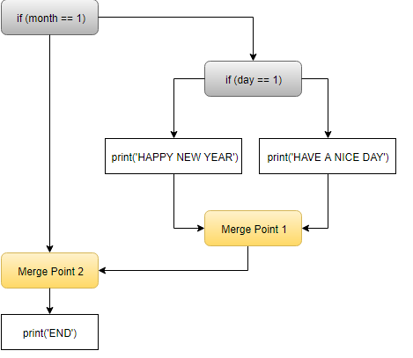
1. if (month == 1) {
2. if (day == 1) {
3. print('HAPPY NEW YEAR');
4. } else {
5. print('HAVE A NICE DAY');
6. }
7. }
8. print('END');

Slide 86
Method 1
V(G)=E-N+2
V(G)=8-7+2=3
Method 2
V(G)=Bounded area+1
2+1=3
Method 3
N+1
2+1=3

Slide 87
Selenium Tool
What Is Selenium?
Selenium is an open source tool which is used for automating the tests carried out on web browsers (Web applications are tested using any web browser).
Selenium is a free (open source) automated testing suite for web applications across different browsers and platforms.
only testing of web applications is possible with Selenium. We can neither test any desktop (software) application nor test any mobile application using Selenium.

Slide 88
Selinium is used to test dynamic web applications and why Selenium is the best for that purpose.
Since Selenium is open-source, there is no licensing cost involved, which is a major advantage over other testing tools.

Slide 89
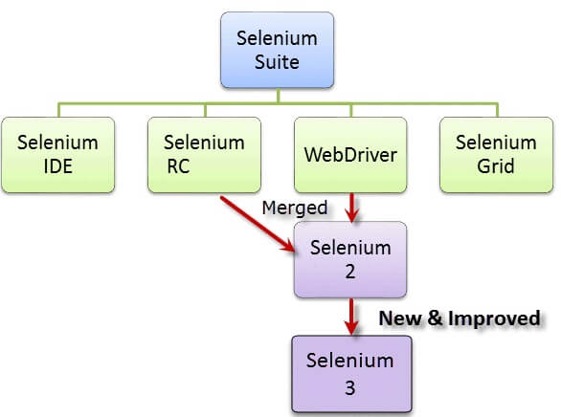
It has four components.
Selenium Integrated Development Environment (IDE)
Selenium Remote Control (RC)
WebDriver
Selenium Grid

